Slide 1
More Practice Problems
Balance the following equations:
CO + O₂ → CO₂
N₂O₅ + H₂O → HNO₃
CH₄ + Cl₂ → CCl₄ + HCl
Al₄C₃ + H₂O → Al(OH)₃ + CH₄

Slide 2
CO + O₂ → CO₂
Which atom should we do first?
C – (O occurs by itself on the left, so we can always balance it using the pure O₂₎
CO + O₂ → CO₂ (Carbon is balanced)
CO + ½ O₂ → CO₂ (balances O, but we like integers)
2CO + O₂ → 2 CO₂

Slide 3
N₂O₅ + H₂O → HNO₃
Which first?
N or H – shouldn’t matter
N₂O₅ + H₂O → 2HNO₃ (I did N first)
N₂O₅ + H₂O → 2 HNO₃ (H second)
N₂O₅ + H₂O → 2 HNO₃ (turns out O is already done!)

Slide 4
CH₄ + Cl₂ → CCl₄ + HCl
Which first?
Either C or H. Cl should definitely be last
CH₄ + Cl₂ → CCl₄ + 4 HCl (H first, C done already)
CH₄ + 4 Cl₂ → CCl₄ + 4 HCl

Slide 5
Al₄C₃ + H₂O → Al(OH)₃ + CH₄
Al₄C₃ + H₂O → 4 Al(OH)₃ + CH₄
Al₄C₃ + H₂O → 4 Al(OH)₃ + 3 CH₄
Al₄C₃ + 12 H₂O → 4 Al(OH)₃ + 3 CH₄

Slide 6
In a chemical reaction Fe₂O₃ + C → Fe + CO₂
When the equation is balanced the sum of the coefficients of reactants should be
2
3
7
5
4
0
of
5
10

Slide 7
CHGM-141
General and Analytical Chemistry I
Lecture 15
(Ch. 6)
with Dr. Bailey
Chemical Equations
Stoichiometry
Balancing Chemical Equations (more practice problems)
Mass Relationships in Chemical Reactions: Stoichiometry
Reactions in Which One Reactant Is Present in Limited Supply
Percent Yield

Slide 8
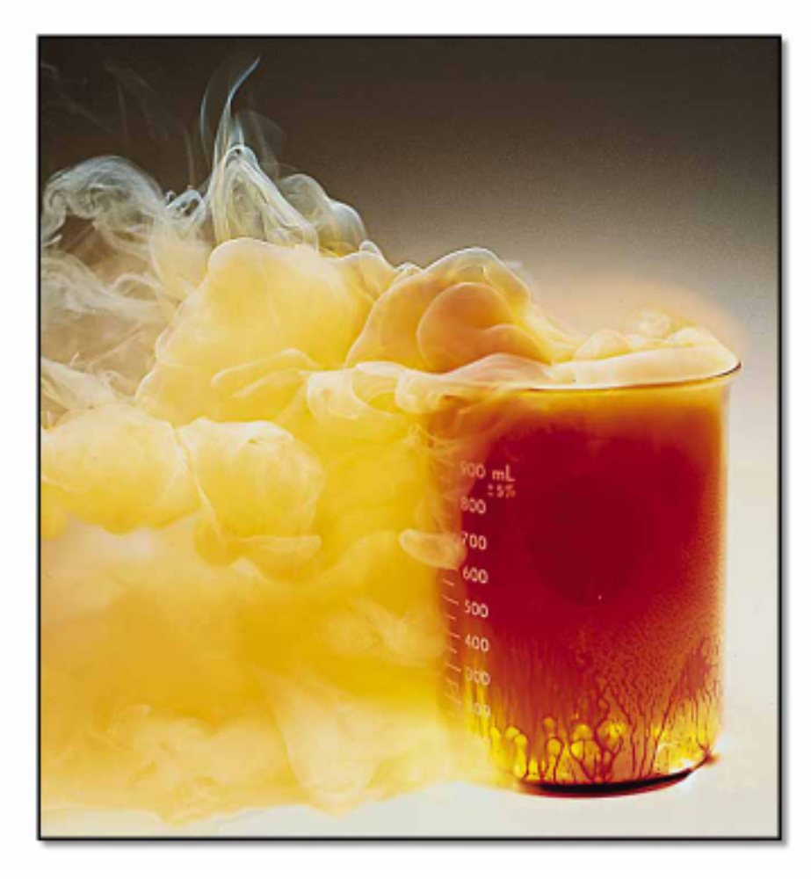
STOICHIOMETRY
- the study of the quantitative aspects of chemical reactions.

Slide 9
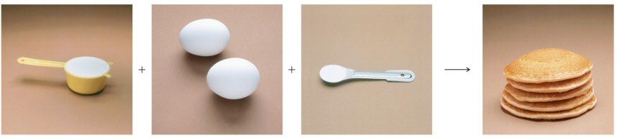
Making Pancakes
The number of pancakes you can make depends on the amount of the ingredients you use.
1 cup flour + 2 eggs + ½ tsp baking powder → 5 pancakes
This relationship can be expressed mathematically.
1 cup flour ≡ 2 eggs ≡ ½ tsp baking powder ≡ 5 pancakes

Slide 10
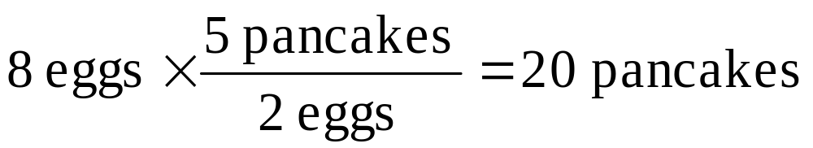
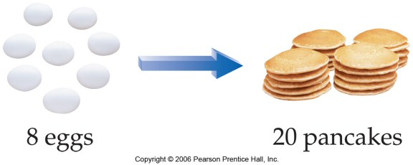
Making Pancakes, Continued
1 cup flour + 2 eggs + ½ tsp baking powder → 5 pancakes
If you want to make more or less than 5 pancakes, you can use the number of eggs you have to determine the number of pancakes you can make.
  Assuming you have enough flour and baking powder.

Slide 11
Balanced Equations
Once I have a balanced equation, I have a very specific recipe:
2 H₂ + O₂ → 2 H₂O
This balanced equation indicates the exact relative amounts of all the chemical species.
The numbers are called stoichiometric coefficients.

Slide 12
2 H₂ + O₂ → 2 H₂O
2 moles H₂:1 mole O₂:2 moles H₂O
This is essentially 6 different ratios:
2 mol H₂ 1 mol O₂ 2 mol H₂O
1 mol O₂ 2 mol H₂O 2 mol H₂
1 mol O₂ 2 mol H₂O 2 mol H₂
2 mol H₂ 1 mol O₂ 2 mol H₂O

Slide 13
Stoichiometric Ratios
These ratios are the relative stoichiometry and are, therefore, called stoichiometric ratios.
Like any other ratios, these are conversion factors – in this case converting one chemical substance into another.

Slide 14
2 H₂ + O₂ → 2 H₂O
If I have 2.5 moles of hydrogen – how much oxygen do I need to completely react the hydrogen?
2.5 mol H₂* 1 mol O₂ = 1.25 mol O₂
2 mol H₂

Slide 15
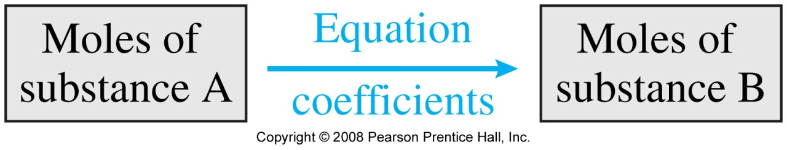
2 H₂ + O₂ → 2 H₂O
If I reacted 2.5 moles of hydrogen – how much water did I create?
2.5 mol H₂* 2 mol H₂O = 2.5 mol H₂O
2 mol H₂

Slide 16
Life as Conversion Factors
So, once again we see the power of conversion factors.
In this case, the stoichiometry is the conversion factor between different chemical species!

Slide 17
Moles is better, Grams is easier
…to measure!
The reactions are all written in terms of molecules (or moles) interacting.
It is easier to measure grams in the laboratory!

Slide 18
A more typical problem
2 H₂ + O₂ → 2 H₂O
What mass of oxygen is required to react with 5.0 g H₂?
Where do we start? What do we do?

Slide 19
A more typical problem
2 H₂ + O₂ → 2 H₂O
What mass of oxygen is required to react with 5.0 g H₂?
5.0 g H₂ * 1 mol H₂ * 1 mol O₂ * 32.0 g O₂ = 39.6 g O₂
2.016 g H₂ 2 mol H₂ 1 mol O₂

Slide 20
Our 1st Dance of Chemistry
GRAMS TO MOLES
MOLES TO MOLES
MOLES TO GRAMS
This is the most common calculation in all of chemistry!

Slide 21
A more typical problem
2 H₂ + O₂ → 2 H₂O
What masses of oxygen and hydrogen are required to create with 5.0 g H₂O?
Where do we start? What do we do?
Grams to moles, moles to moles, moles to grams

Slide 22
A more typical problem
2 H₂ + O₂ → 2 H₂O
What masses of oxygen and hydrogen are required to create with 5.0 g H₂O?
5.0 g H₂O * 1 mol H₂O * 1 mol O₂ * 32.0 g O₂ = 4.4 g O₂
18.016 g H₂O 2 mol H₂O 1 mol O₂
5.0 g H₂O * 1 mol H₂O * 2 mol H₂ * 2.016 g H₂ = 0.56 g H₂
18.016 g H₂O 2 mol H₂O 1 mol H₂

Slide 23
A more typical problem
2 H₂ + O₂ → 2 H₂O
What masses of oxygen and hydrogen are required to create with 5.0 g H₂O?
4.44 g O₂
0.56 g H₂
Both are required! Doesn’t matter how much oxygen you have if you don’t have any hydrogen!

Slide 24
GENERAL PLAN FOR STOICHIOMETRY CALCULATIONS
Mass
reactant
Mass
product
Stoichiometric
factor
Moles
reactant
Moles
product
Limiting Reagents…

Slide 25
The amount of product isolated from a chemical reaction is almost always less than the calculated, or maximum, amount
The theoretical yield is the amount that would be recovered if no loss occurred (the calculated, maximum amount)
The actual yield is the amount of the desired product isolated
The percentage yield is the actual yield as a percentage of the theoretical yield
In equation form…

Slide 26
Limiting Reagents
When you just can’t get enough!

Slide 27
2 eggs + 1 cup flour → 3 cookies
If I only have a dozen eggs, how many cookies can I make?
NONE – I have no flour!
If I only have 6 cups of flour, how many cookies can I make?
NONE – I have no eggs!

Slide 28
2 eggs + 1 cup flour →3 cookies
If I have a dozen eggs, and 10 cups of flour, how many cookies can I make?
18 – then I’m out of eggs.
If I have 6 eggs and 2 cups of flour, how many cookies can I make?
Six – then I’m out of flour.

Slide 29

How many sandwiches can I make with 10 lettuce, 10 ham, 14 bread, 9 cheese?
10
14
7
5
9
0
of
5
2 slices bread
2 slices ham
1 slice cheese
1 piece lettuce
Another example…

Slide 30
CONGRATULATIONS!
You now understand Limiting Reagents!

Slide 31
Emphasis on “limiting”
The key to “limiting reagents” is the limiting.
In most reactions, there is neither an infinite supply of reactants nor a perfect balance between the finite supply.
In most reactions, you run out of 1 reactant before any of the others and the reaction stops.

Slide 32
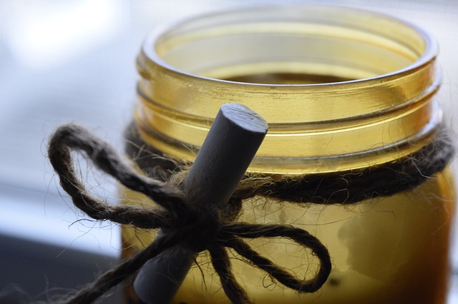
Have you ever left a candle to burn out? If you have, you may have noticed that the candle stopped burning when the wax was gone.
What would happen if you placed a candle in a jar decided to close the jar? The candle will probably burn for a while, but then it will stop burning even though there is plenty of wax left. This is because in a closed jar the candle only has a limited amount of oxygen available. The candle needs oxygen to keep burning.
If the candle is in an open container, the amount of oxygen available is high and the wax runs out before the oxygen does. Therefore, in an open container the amount of time the candle burns for is limited by the amount of wax, whereas in a closed container it is limited by the amount of oxygen.

Slide 33
Sample Problem 1
E.g. How many grams of NO can form when 30.0 g NH₃ and 40.0 g O₂ react according to:
4 NH₃ + 5 O₂ → 4 NO + 6 H₂O
Analysis: This is a limiting reactant problem
So…
  What are our stoichiometric equivalencies?
  How many moles each of NH₃ and O₂ do we have?
  What is the maximum amount of NO we can make with each of these reactant quantities?
Let’s solve…

Slide 34
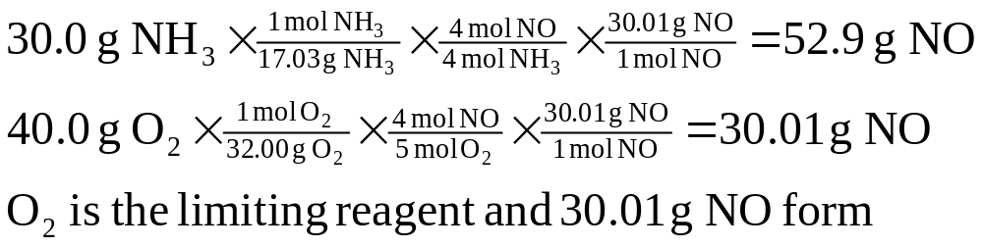
E.g. How many grams of NO can form when 30.0 g NH₃ and 40.0 g O₂ react according to:
4 NH₃ + 5 O₂ → 4 NO + 6 H₂O
  Solution:
= 1.762 mol NH₃
Keep going…

Slide 35
E.g. How many grams of NO can form when 30.0 g NH₃ and 40.0 g O₂ react according to:
4 NH₃ + 5 O₂ → 4 NO + 6 H₂O
  Solution:
= 1.762 mol NO

Slide 36
E.g. How many grams of NO can form when 30.0 g NH₃ and 40.0 g O₂ react according to:
4 NH₃ + 5 O₂ → 4 NO + 6 H₂O
  Solution:

Slide 37
E.g. How many grams of NO can form when 30.0 g NH₃ and 40.0 g O₂ react according to:
4 NH₃ + 5 O₂ → 4 NO + 6 H₂O
  Solution:

Slide 38
E.g. How many grams of NO can form when 30.0 g NH₃ and 40.0 g O₂ react according to:
4 NH₃ + 5 O₂ → 4 NO + 6 H₂O
  Solution:

Slide 39
Why?
Because the limiting reagent will limit the products from forming and so will lead to the smallest (most limited) amount of product.

Slide 40
Yield!
Theoretical Yield = amount you expect to get
Actual Yield = amount you actually get
% yield = actual yield x 100
theoretical yield

Slide 41
Sample Problem 2
2 H₂ + O₂ → 2 H₂O
8.35 g of hydrogen and 15.32 g of oxygen are mixed and allowed to react. Which is the limiting reagent? What is the theoretical yield of water?
Grams is good, MOLES! MOLES! MOLES! IS BETTER!

Slide 42
2 H₂ + O₂ → 2 H₂O
8.35 g H₂ * 1 mol H₂ = 4.14 mol H₂
2.016 g H₂
15.32 g O₂ * 1 mol O₂ = 0.479 mol O₂
32.00 g O₂
4.14 mol H₂ * 2 mol H₂O = 4.14 mol H₂O
2 mol H₂
0.479 mol O₂ * 2 mol H₂O = 0.958 mol H₂O
1 mol O₂

Slide 43
O₂ is the Limiting Reagent
It can make the least amount of product.
After you make 0.958 mol H₂O, it doesn’t matter how much hydrogen you have.
You are DONE, because you are out of O₂!

Slide 44
Theoretical Yield
0.958 mol H₂O * 18.01 g H₂O = 17.2 g H₂O
1 mol H₂O
Notice, this is another case of The Dance!
g → mol → mol → g

Slide 45
Sample Problem 3
N₂ + H₂ → NH₃
Ammonia can be made from the gas phase reaction of nitrogen and hydrogen. 36.06 g of nitrogen and 12.53 g of hydrogen were mixed and reacted for 72 hours at 850 °C.
How many grams of ammonia would you expect to produce?
If 22.86 g NH₃ were collected, what is the % yield of the reaction?

Slide 46
N₂ + 3 H₂ → 2 NH₃
36.06 g N₂ * 1 mol N₂ * 2 mol NH₃ = 2.57 mol NH₃
28.014 g N₂ 1 mol N₂
12.53 g H₂ * 1 mol H₂ * 2 mol NH₃ = 4.14 mol NH₃
2.016 g H₂ 3 mol H₂
N₂ is the limiting reagent
2.57 mol NH₃ * 17.03 g NH₃ = 43.77 g NH₃
1 mol NH₃

Slide 47
Yield!
Theoretical Yield = amount you expect to get
Actual Yield = amount you actually get
% yield = actual yield x 100
theoretical yield

Slide 48
Yield!
22.86 g NH₃ actual x 100 = 52.23 % yield
43.77 g NH₃ expected
UNITS! UNITS! UNITS!
52.23 % yield = 52.23 g actual
100 g expected

Slide 49
Sample Problem 4
N₂ + 3 H₂ → 2 NH₃
Ammonia can be made from the gas phase reaction of nitrogen and hydrogen. 25.00 g of nitrogen and 8.00 g of hydrogen were mixed and reacted for 72 hours at 850 °C.
How many grams of ammonia would you expect to produce if the reaction proceeds with a 76% yield?

Slide 50
N₂ + 3 H₂ → 2 NH₃
25.00 g N₂ * 1 mol N₂ * 2 mol NH₃ = 1.785 mol NH₃
28.014 g N₂ 1 mol N₂
8.00 g H₂ * 1 mol H₂ * 2 mol NH₃ = 2.65 mol NH₃
2.016 g H₂ 3 mol H₂
N₂ is the limiting reagent
1.785 mol NH₃ * 17.03 g NH₃ = 30.40 g NH₃ theoretical
1 mol NH₃

Slide 51
Actual Yield?
30.40 g NH₃ expected
76% yield
Just another UNITS! UNITS! UNITS! problem:
76 % NH₃ actual * 30.49 g NH₃ expected = 23.10 g NH₃ actual
100 % NH₃ expected

